Slide 1

Professional Practices (HUM-305)
SPRING SEMESTER 2026
By
Prof Engr Muhammad Raheel Iqbal Butt
Resource Person
Contact: +92 321 7433568
School of Computer & Information Technology
Beaconhouse National University, Lahore

Slide 2


Slide 3
Chap 13 Accountability and Auditing
Accountability and Auditing
Social Application of Ethics.

Slide 4


Slide 5
Introduction to Accountability
Core Concept: Accountability is the obligation of an organization or individual to account for its activities, accept responsibility for them, and disclose results in a transparent manner.
The Four Pillars:
Responsibility: The duty to perform assigned tasks.
Answerability: Being called to explain decisions and actions.
Trustworthiness: Building reliance through ethical conduct.
Liability: Being bound by obligation or debt.
Speaker Notes: Accountability transforms passive duty into active action. It prevents power abuse and establishes the framework for how institutions interact with stakeholders.

Slide 6
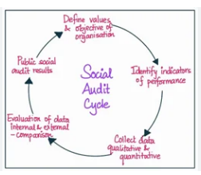

Slide 7
Understanding Auditing
Core Concept: Auditing is the independent, systematic examination of records, processes, and controls to ensure statements are accurate and complete.
Types of Audits:
Financial Audits: Evaluate the accuracy and fairness of financial records.
Operational Audits: Analyze efficiency and performance within the organization.
Compliance Audits: Ensure adherence to internal policies and external legal frameworks.
Speaker Notes: Auditing is not just about finding errors; it is the vital verification step that proves an entity's claims are honest, independent, and free from material misstatement.

Slide 8


Slide 9
Ethical Principles in Auditing
Fundamental Standards: Auditors must adhere to core professional ethics. Key principles include:
Integrity: Being honest, fair, and candid.
Objectivity: Making impartial judgments free from bias or conflicts of interest.
Professional Competence: Maintaining the necessary knowledge and skill.
Confidentiality: Protecting non-public information unless disclosure is required by law.
Speaker Notes: Without absolute independence and objectivity, an audit loses its value. The entire auditing profession relies on the public's trust in the auditor's ethical standing.

Slide 10
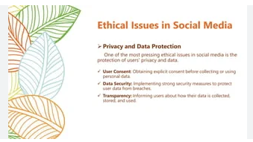

Slide 11
Defining the Social Application of Ethics
Core Concept: The integration of moral principles and values into the structures of society to guide behavior, institutional policies, and decision-making.
Key Areas of Application:
Corporate & Business Ethics: Fair treatment of employees, responsible sourcing, and environmental sustainability.
Media & Digital Ethics: Objectivity, transparency, and mitigating misinformation in journalism and social media.
Public Administration: Serving the public interest and protecting state resources.
Speaker Notes: Ethics are not just for personal life; they govern how societies solve large problems, such as resource distribution, discrimination, and corporate governance.

Slide 12
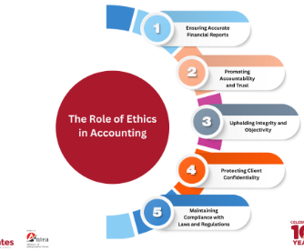

Slide 13
Ethics Auditing in Organizations
Core Concept: The systematic evaluation of an organization's ethics program, culture, and social responsibility performance.
What is Measured:
Employee treatment and workplace safety.
Compliance with labor laws and environmental standards.
Philanthropic efforts and stakeholder relationships.
Speaker Notes: An ethics audit helps organizations identify potential reputational and legal risks before they escalate. It transitions compliance from a minimum legal requirement to a core part of organizational culture.

Slide 14
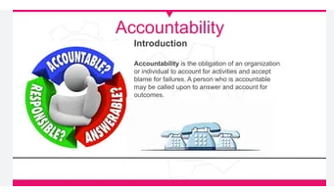

Slide 15
Social Auditing
Core Concept: The process of assessing and reporting on a company’s or government's performance in fulfilling its economic, legal, and social responsibilities.
Key Mechanisms:
Participatory Budgeting & Citizen Monitoring: Involving the public in evaluating development and community programs.
Public Expenditure Tracking: Making the flow of funds transparent so resources actually reach beneficiaries.
Speaker Notes: Social Auditing bridges the gap between official data and reality. It serves as a tool for communities and civil societies to exact Social Accountability from organizations.

Slide 16
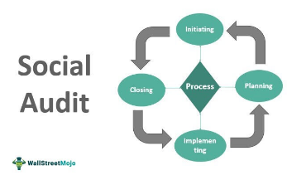

Slide 17
Challenges in Measuring Ethical Performance
The Measurement Problem: Unlike financial audits which deal with exact numbers, ethics and social performance often rely on qualitative, non-financial data.
Key Challenges:
Quantifying "culture" and "integrity."
Avoiding "greenwashing" or superficial reporting.
Balancing profitability with societal obligations.
Speaker Notes: Measuring the social application of ethics is difficult but necessary. Developing standardized frameworks—such as ESG (Environmental, Social, and Governance) reporting—helps standardize these evaluations.

Slide 18
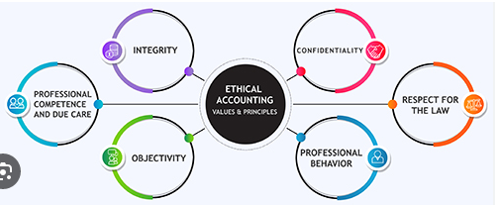

Slide 19
The Way Forward – Building an Ethical Culture
Best Practices:
Clear Codes of Conduct: Outlining expected behaviors, consequences, and disciplinary procedures.
Whistleblower Protection: Providing secure channels for reporting unethical behavior without fear of retaliation.
Continuous Monitoring: Integrating regular ethical risk assessments alongside financial audits.
Speaker Notes: Accountability, auditing, and ethical application are not standalone tasks; they are interconnected systems that ensure long-term sustainability and trust within society.

Slide 20


Slide 21


